Slide 1
3.3: Properties of Logarithms
MATH 1550 - Precalculus

Slide 2
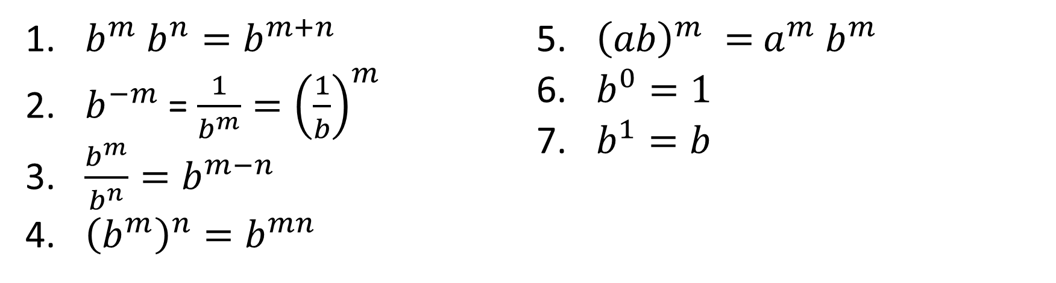
Recall: Properties of Exponents
Let a, b, m, n be any real numbers such that m > 0, n > 0, b ≠ 0. Then,
$b^{m}$ $b^{n}=b^{m+n}$
$b^{−m}$ = ${\frac{1}{b^{m}}=\left(\frac{1}{b}\right)}^{m}$
$\frac{b^{m}}{b^{n}}=b^{m−n}$
${\left(b^{m}\right)}^{n}=b^{mn}$
${\left(ab\right)}^{m} =$ $a^{m}$ $b^{m}$
$b^{0}=1$
$b^{1}=b$

Slide 3
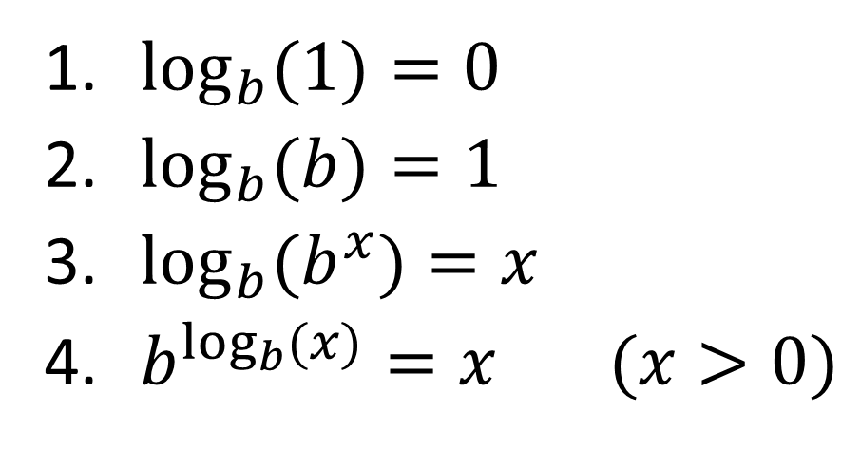
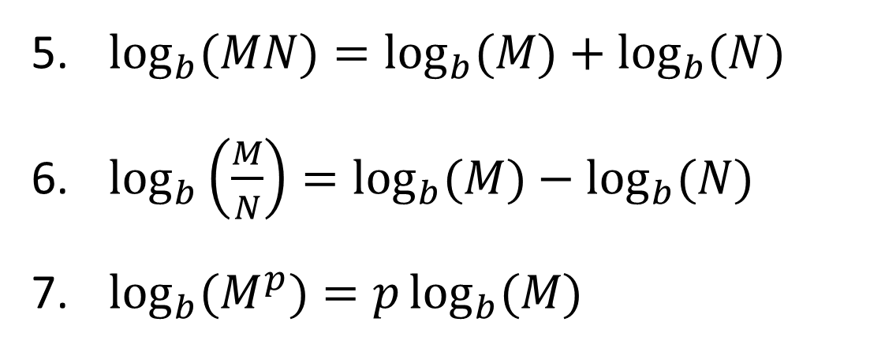
Properties of Logarithms
Let b, M, N be positive real numbers where b ≠ 1. Then, if x, p are real
$\log_{b}{(1)}=0$
$\log_{b}{(b)}=1$
$\log_{b}{(b^{x})}=x$
$b^{\log_{b}{(x)}}=x (x>0)$
$\log_{b}{(MN)}=\log_{b}{(M)}+\log_{b}{(N)}$
$\log_{b}\left(\frac{M}{N}\right)=\log_{b}{(M)}−\log_{b}{(N)}$
$\log_{b}{(M^{p})}=p\log_{b}{(M)}$
(Product Rule)
(Quotient Rule)
(Power Rule)

Slide 4
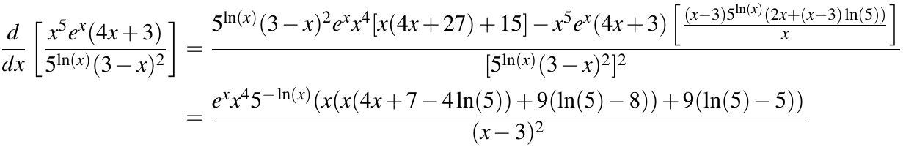
Applications of Logarithms in Calculus
In Calculus, you may be asked to find a property of a function known as the derivative.
Clearly, trying find the derivative of the given function all at once can be extremely messy and error-prone.

Slide 5
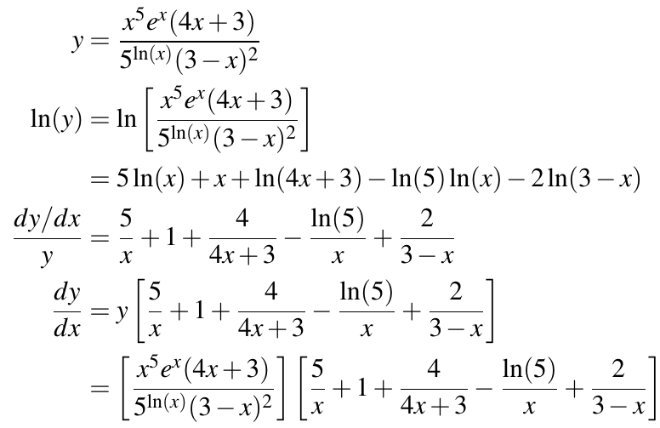
Applications of Logarithms in Calculus
However, using the properties of logarithms we learned today, we can break the function down into smaller pieces, which makes the problem easier to tackle.

